Slide 1
Create A Travel/Tourism Website Using HTML and CSS Code

Slide 2
This post will teach you how to create a Travel Website (Tourism Website) Using HTML and CSS Code. The webpage I’m going to share with you in this article is about travelling. It’s quite simple, and you’ll have your own Travel Tourism Website by the end of this article.

Slide 3
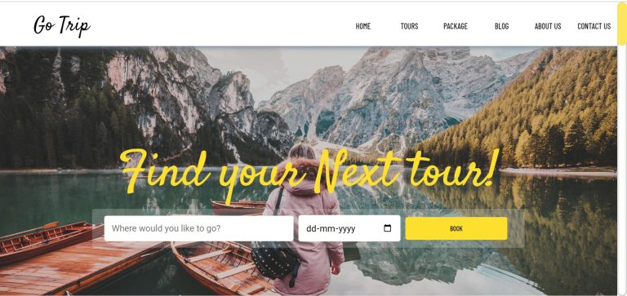

Slide 4
A travel website is a sort of business that provides customers with travel-related services. When it comes to the future of this industry, there are numerous aspects that will influence how consumers plan their vacations. The rise of mobile usage, greater competition, and a shift in customer expectations are among these factors. The ideal tool for tourists is the travel website creator.

Slide 5
People are increasingly using their mobile gadgets when travelling, for example. As a result, businesses should ensure that their websites are mobile-friendly. To enhance their profits, companies employ an easy website builder for small enterprises. They should also be aware that competition among online booking sites is increasing

Slide 6
We will go over this project step by step.

Slide 7
Step 1
Setting Up the Structure (HTML)

Slide 8
Let us begin by establishing a Travel/Tourism project. Create a new index.html file in a new subdirectory to house the website layout. Copy and paste the HTML code given below into your html file.

Slide 9
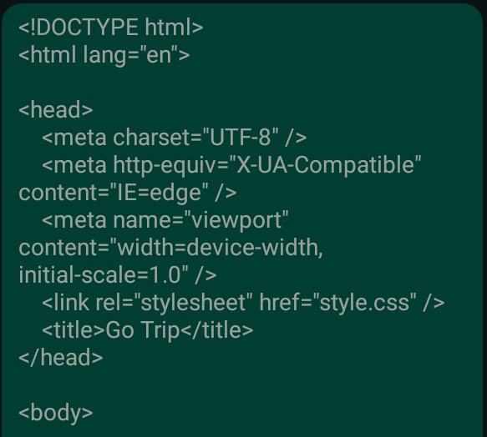

Slide 10
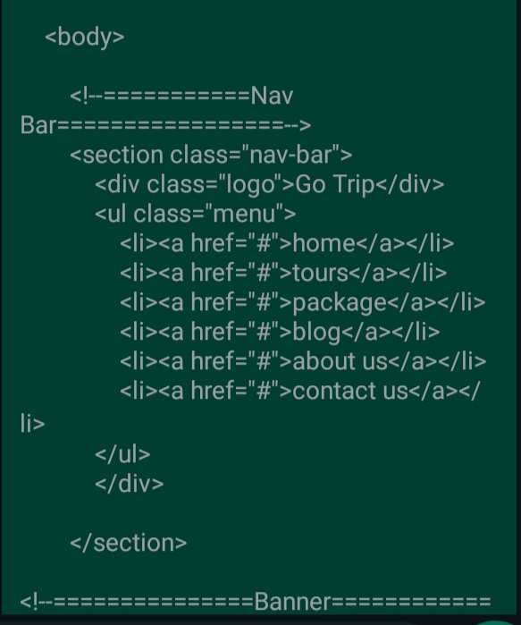

Slide 11
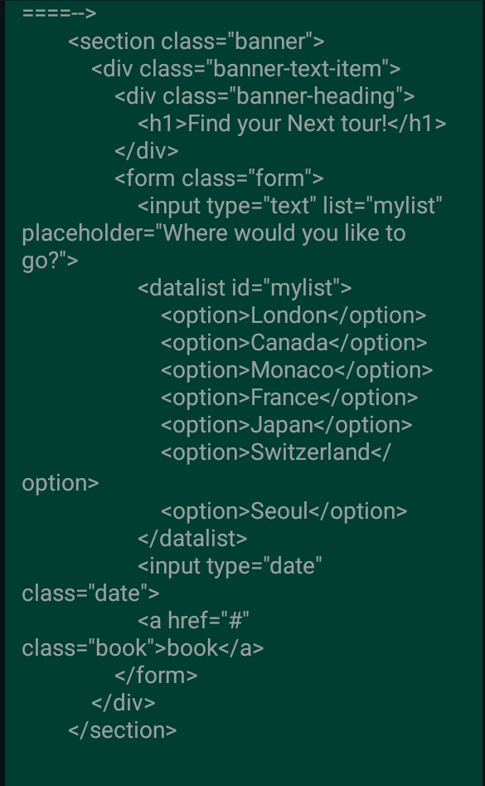

Slide 12
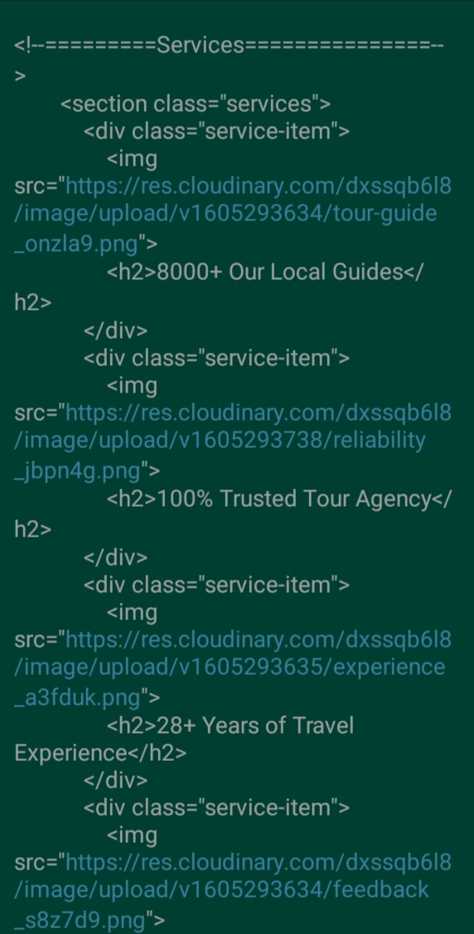

Slide 13
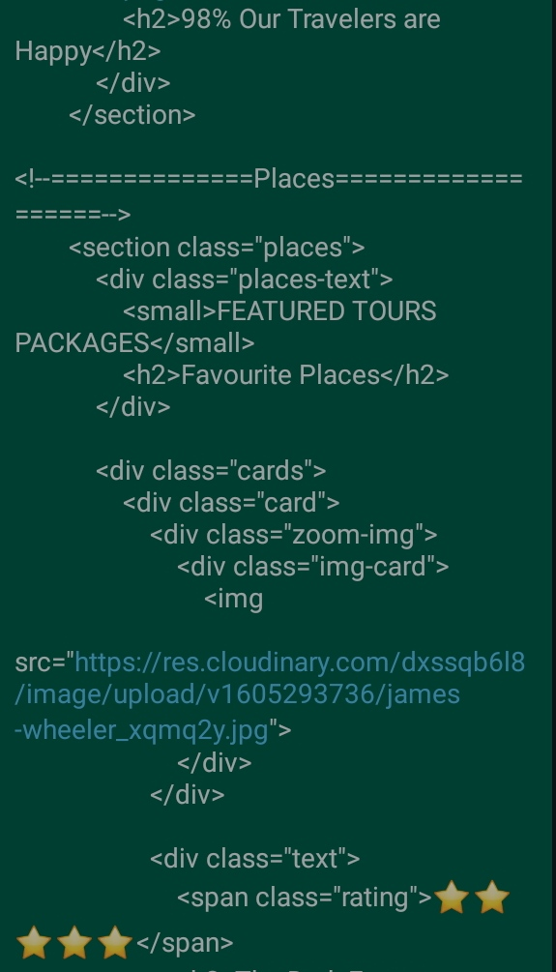

Slide 14
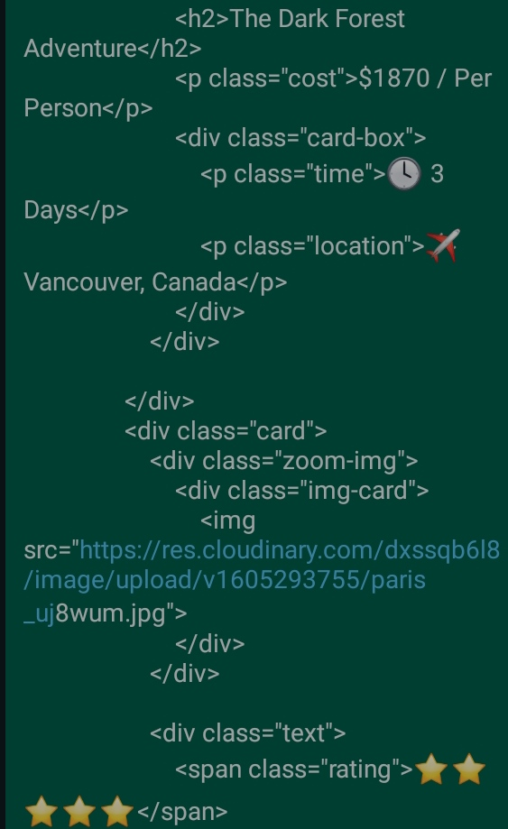

Slide 15
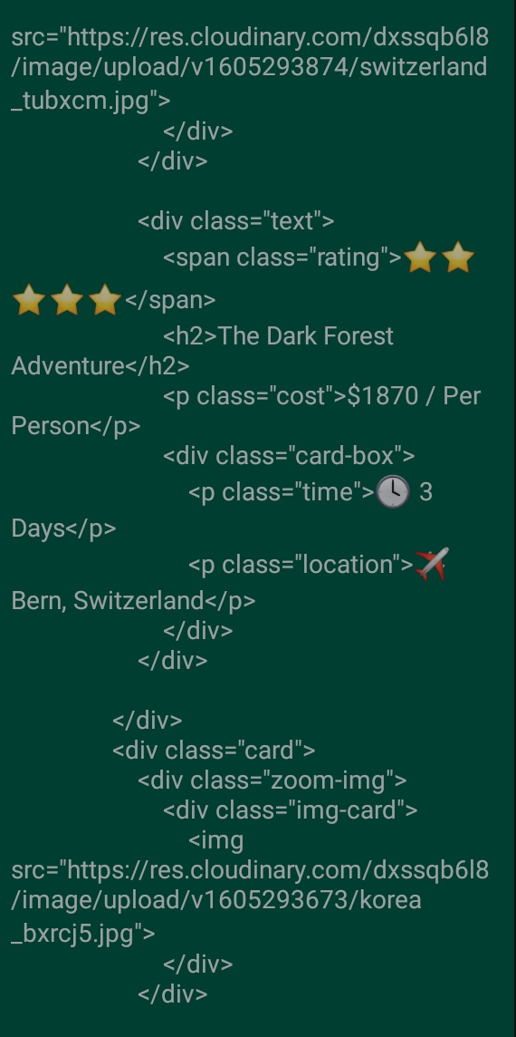

Slide 16
Every website has three sections: the header, the main body, and the footer. In our project, we will use the same procedure; we will build a header section where we will add the heading, and we will add the main content inside the main section

Slide 17
Header Section of travel website
First, in the header section of our website, we will add a navbar for our travel website using the <nav> tag, and inside the nav tag, we will create different navbar links for our website navbar using an unordered list

Slide 18
Inside our header section, we will add another section called “banner,” within which we will add a heading using the <h1> tag; a text input box using the form tag; a menu list for selecting the countries from the menu list; an input of type “date” to select the date from the calendar; and a book button using the <a> tag.

Slide 19
Body Section of travel website
In the body section, we will develop three sections: one for services, one for places, and one for about us. In this section, we will introduce several structures. Within our services section, we will use the <div> to create a container for our service items, and within our div tag, we will add an image and a sub-heading using the <h2>, as well as three more service items.

Slide 20
Concerning the places portion, we will create the locations in card format. In our places sections, we will first create some div tags, and within those, we will add an image related to the place using the img> tag, and the text for that place using another div tag. We’ll use the span and h2 tags inside that div to add a rating for the place, and the h2 tag to add the subheading of our place items. We’ll make 5 more image cards with zoom features like this one.

Slide 21
Now, within our about section, we will use the <section> tag to create another section for about us, and within that, we will use the< img> tag to add a display image about our organisation, and we will use the general html element to give a brief explanation about our website.

Slide 22
Footer Section:
We’ll use the footer tag to create a footer section and the <div> tag to create a div section. Using the &copy tag, we will add the copyright emblem and copyright material, as well as the name of the person who designed the website, using the <p> tag. We will generate links for the footer using the unordered list and the <h3> tag. We will include a heading for the quick link, as well as additional items and support

Slide 23
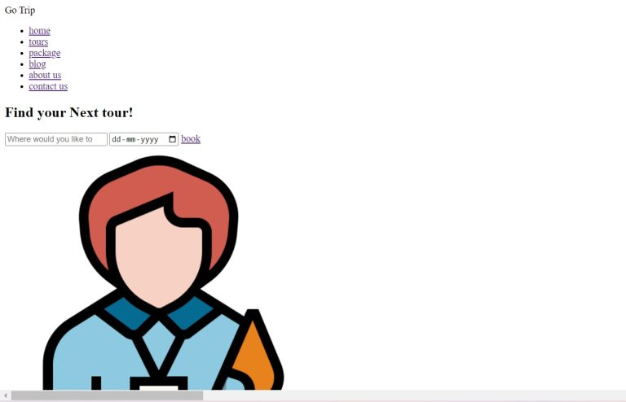

Slide 24
Step2: Styling the Travel Website (CSS)
How we can style our website. I’ll highlight some key points to remember when styling

Slide 25
Default Styling:
We will import several new fonts for our travel website via Google’s import link using the @import url function

Slide 26
Navbar Styling:

Slide 27
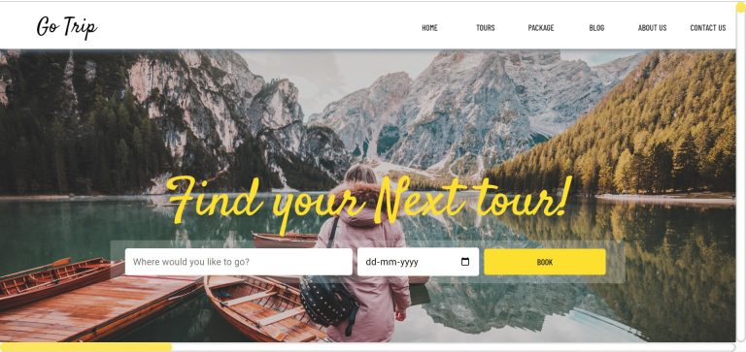
Styling Banner:

Slide 28
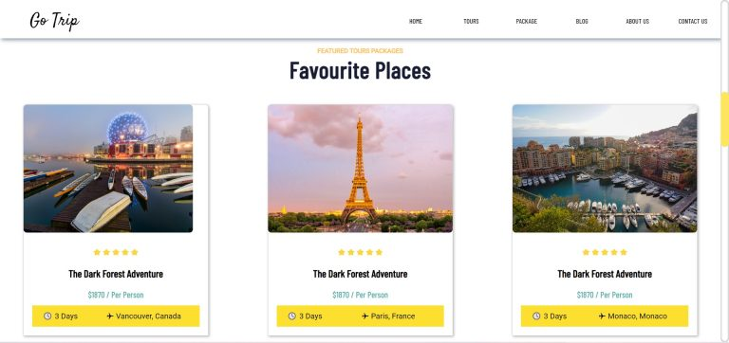
Styling the Services and Places Section

Slide 29
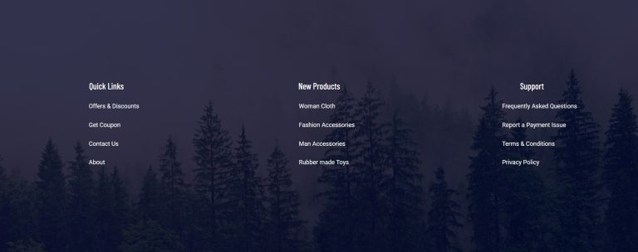
Styling footer:

Slide 30
Final Output of Travel/Tourism Website

